Slide 1
Properties of Context-Free Languages
Chapter 7 (Part 1)

Slide 2
Contents
Eliminating Useless Variables
Removing Epsilon
Removing Unit Productions
Chomsky Normal Form

Slide 3
Simplification of CFG
In CFG, sometimes all the production rules and symbols are not needed for the derivation of strings.
Besides this, there may also be some NULL productions and UNIT productions.
Elimination of these productions and symbols is called simplification of CFG.

Slide 4
Variables That Derive Nothing
Consider: S -> AB, A -> aA | a, B -> AB
Although A derives all strings of a’s, B derives no terminal strings (can you prove this fact?).
Thus, S derives nothing, and the language is empty.

Slide 5
Testing Whether a Variable Derives Some Terminal String
Basis: If there is a production A -> w, where w has no variables, then A derives a terminal string.
Induction: If there is a production A -> α, where α consists only of terminals and variables known to derive a terminal string, then A derives a terminal string.

Slide 6
Testing – (2)
Eventually, we can find no more variables.
An easy induction on the order in which variables are discovered shows that each one truly derives a terminal string.
Conversely, any variable that derives a terminal string will be discovered by this algorithm.

Slide 7
Proof of Converse
The proof is an induction on the height of the least-height parse tree by which a variable A derives a terminal string.
Basis: Height = 1. Tree looks like:
Then the basis of the algorithm
tells us that A will be discovered.
A
a₁
. . .
a_{n}

Slide 8
Induction for Converse
Assume IH for parse trees of height < h, and suppose A derives a terminal string via a parse tree of height h:
By IH, those X_{i}’s that are
variables are discovered.
Thus, A will also be discovered, because it has a right side of terminals and/or discovered variables.
A
X₁
. . .
X_{n}
w₁
w_{n}

Slide 9
Algorithm to Eliminate Variables That Derive Nothing
Discover all variables that derive terminal strings.
For all other variables, remove all productions in which they appear either on the left or the right.

Slide 10
Example: Eliminate Variables
S -> AB | C, A -> aA | a, B -> bB, C -> c
Basis: A and C are identified because of A -> a and C -> c.
Induction: S is identified because of S -> C.
Nothing else can be identified.
Result: S -> C, A -> aA | a, C -> c

Slide 11
Unreachable Symbols
Another way a terminal or variable deserves to be eliminated is if it cannot appear in any derivation from the start symbol.
Basis: We can reach S (the start symbol).
Induction: if we can reach A, and there is a production A -> α, then we can reach all symbols of α.

Slide 12
Unreachable Symbols – (2)
Easy inductions in both directions show that when we can discover no more symbols, then we have all and only the symbols that appear in derivations from S.
Algorithm: Remove from the grammar all symbols not discovered reachable from S and all productions that involve these symbols.

Slide 13
Eliminating Useless Symbols
A symbol is useful if it appears in some derivation of some terminal string from the start symbol.
Otherwise, it is useless.
Eliminate all useless symbols by:
  Eliminate symbols that derive no terminal string.
  Eliminate unreachable symbols.

Slide 14
Example: Useless Symbols – (2)
S -> AB, A -> C, C -> c, B -> bB
If we eliminated unreachable symbols first, we would find everything is reachable.
A, C, and c would never get eliminated.

Slide 15
Why It Works
After step (1), every symbol remaining derives some terminal string.
After step (2) the only symbols remaining are all derivable from S.
In addition, they still derive a terminal string, because such a derivation can only involve symbols reachable from S.

Slide 16

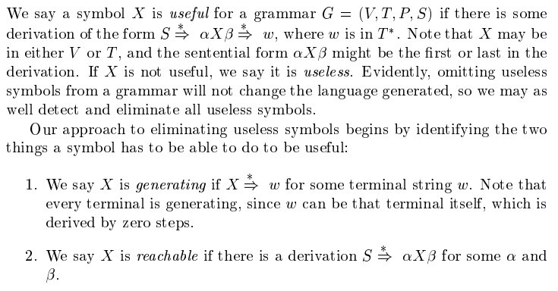
Useless symbols (Textbook)

Slide 17
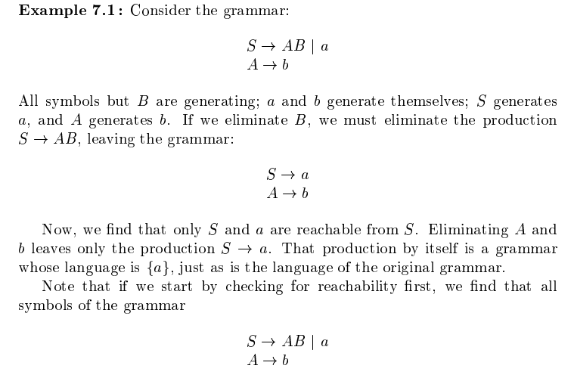

Example

Slide 18
Epsilon Productions
We can almost avoid using productions of the form A -> ε (called ε-productions ).
  The problem is that ε cannot be in the language of any grammar that has no ε–productions.
Theorem: If L is a CFL, then L-{ε} has a CFG with no ε-productions.

Slide 19
Nullable Symbols
To eliminate ε-productions, we first need to discover the nullable variables = variables A such that A =>* ε.
Basis: If there is a production A -> ε, then A is nullable.
Induction: If there is a production A -> α, and all symbols of α are nullable, then A is nullable.

Slide 20
Example: Nullable Symbols
S -> AB, A -> aA | ε, B -> bB | A
Basis: A is nullable because of A -> ε.
Induction: B is nullable because of B -> A.
Then, S is nullable because of S -> AB.

Slide 21
Eliminating ε-Productions
Key idea: turn each production A -> X₁…X_{n} into a family of productions.
For each subset of nullable X’s, there is one production with those eliminated from the right side “in advance.”
  Except, if all X’s are nullable, do not make a production with ε as the right side.

Slide 22
Example: Eliminating ε-Productions
S -> ABC, A -> aA | ε, B -> bB | ε, C -> ε
A, B, C, and S are all nullable.
New grammar:
S -> ABC | AB | AC | BC | A | B | C
A -> aA | a
B -> bB | b
Note: C is now useless.
Eliminate its productions.

Slide 23
Why it Works
Prove that for all variables A:
  If w ≠ ε and A =>*_{old} w, then A =>*_{new} w.
  If A =>*_{new} w then w ≠ ε and A =>*_{old} w.
Then, letting A be the start symbol proves that L(new) = L(old) – {ε}.
(1) is an induction on the number of steps by which A derives w in the old grammar.

Slide 24
Proof of 1 – Basis
If the old derivation is one step, then A -> w must be a production.
Since w ≠ ε, this production also appears in the new grammar.
Thus, A =>_{new} w.

Slide 25
Proof of 1 – Induction
Let A =>*_{old} w be an n-step derivation, and assume the IH for derivations of less than n steps.
Let the first step be A =>_{old} X₁…X_{n}.
Then w can be broken into w = w₁…w_{n},
where X_{i} =>*_{old} w_{i}, for all i, in fewer than n steps.

Slide 26
Induction – Continued
By the IH, if w_{i} ≠ ε, then X_{i} =>*_{new} w_{i}.
Also, the new grammar has a production with A on the left, and just those X_{i}’s on the right such that w_{i} ≠ ε.
  Note: they all can’t be ε, because w ≠ ε.
Follow a use of this production by the derivations X_{i} =>*_{new} w_{i} to show that A derives w in the new grammar.

Slide 27
Proof of Converse
We also need to show part (2) – if w is derived from A in the new grammar, then it is also derived in the old.
Induction on number of steps in the derivation.
We’ll leave the proof for reading in the text.

Slide 28
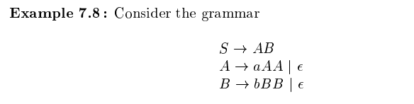

Example
The resultant grammar after eliminating epsilon-productions:

Slide 29
Unit Productions
A unit production is one whose right side consists of exactly one variable.
These productions can be eliminated.
Key idea: If A =>* B by a series of unit productions, and B -> α is a non-unit-production, then add production A -> α.
Then, drop all unit productions.

Slide 30
Unit Productions – (2)
Find all pairs (A, B) such that A =>* B by a sequence of unit productions only.
Basis: Surely (A, A).
Induction: If we have found (A, B), and B -> C is a unit production, then add (A, C).

Slide 31
Proof That We Find Exactly the Right Pairs
By induction on the order in which pairs (A, B) are found, we can show A =>* B by unit productions.
Conversely, by induction on the number of steps in the derivation by unit productions of A =>* B, we can show that the pair (A, B) is discovered.

Slide 32
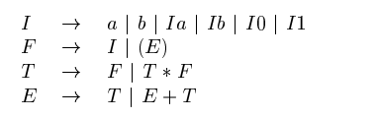
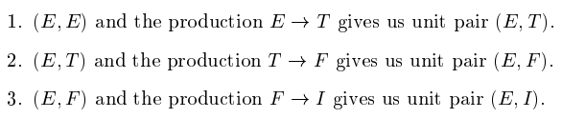
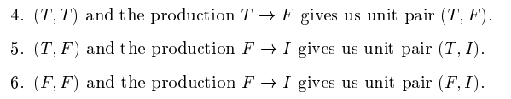
Example (Eliminating unit-productions)
Consider the following grammar:

Slide 33
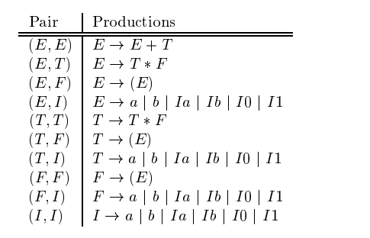
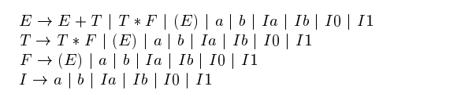
Contd…

Slide 34
Cleaning Up a Grammar
Theorem: if L is a CFL, then there is a CFG for L – {ε} that has:
  No useless symbols.
  No ε-productions.
  No unit productions.
I.e., every right side is either a single terminal or has length > 2.

Slide 35
Cleaning Up – (2)
Proof: Start with a CFG for L.
Perform the following steps in order:
  Eliminate ε-productions.
  Eliminate unit productions.
  Eliminate variables that derive no terminal string.
  Eliminate variables not reached from the start symbol.
Must be first. Can create
unit productions or useless
variables.

Slide 36
Chomsky Normal Form
A CFG is said to be in Chomsky Normal Form if every production is of one of these two forms:
  A -> BC (right side is two variables).
  A -> a (right side is a single terminal).
Theorem: If L is a CFL, then L – {ε} has a CFG in CNF.

Slide 37
Proof of CNF Theorem
Step 1: “Clean” the grammar, so every production right side is either a single terminal or of length at least 2.
Step 2: For each right side ≠ a single terminal, make the right side all variables.
  For each terminal a create new variable A_{a} and production A_{a} -> a.
  Replace a by A_{a} in right sides of length > 2.

Slide 38
Example: Step 2
Consider production A -> BcDe.
We need variables A_{c} and A_{e}. with productions A_{c} -> c and A_{e} -> e.
  Note: you create at most one variable for each terminal, and use it everywhere it is needed.
Replace A -> BcDe by A -> BA_{c}DA_{e}.

Slide 39
CNF Proof – Continued
Step 3: Break right sides longer than 2 into a chain of productions with right sides of two variables.
Example: A -> BCDE is replaced by A -> BF, F -> CG, and G -> DE.
  F and G must be used nowhere else.

Slide 40
Example of Step 3 – Continued
Recall A -> BCDE is replaced by A -> BF, F -> CG, and G -> DE.
In the new grammar, A => BF => BCG => BCDE.
More importantly: Once we choose to replace A by BF, we must continue to BCG and BCDE.
  Because F and G have only one production.

Slide 41
CNF Proof – Concluded
We must prove that Steps 2 and 3 produce new grammars whose languages are the same as the previous grammar.
Proofs are of a familiar type and involve inductions on the lengths of derivations.

Slide 42
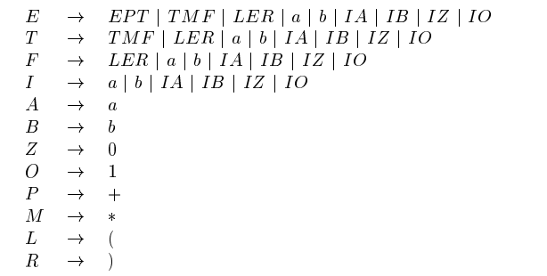

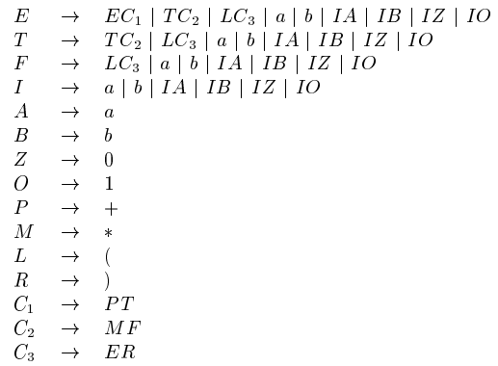
CNF-Example

